Slide 1
Training Units and Developing Leaders for Full Spectrum Operations

Slide 2
Lesson Scope
The objective of this lesson on FM 7-0, Training Units and Developing Leaders for Full Spectrum Operations, February 2011, is to increase your knowledge and fundamental understanding of the Army’s newest keystone training manual/doctrine. The outcome of the lesson is that you fully understand the role of training modular, expeditionary Army forces and developing leaders to conduct full spectrum operations in an era of persistent conflict.
This lesson will allow you to gain a full appreciation of the scope and complexities that challenge Army leaders and organizations as they train for full spectrum operations. The classroom discussion will address both the intellectual basis for the Army’s training doctrine and the differences between this version of the Army’s training manual and past versions. The classroom discussion will also address: training for complex operational environments, the Army’s principles of unit training and leader development, the Army’s training management model, the Commander’s role in training, and the Army’s force generation (ARFORGEN) process.

Slide 3
Why Change Now?
Nature of the operational environment (OE) &
hybrid threats have evolved
We are a modular, brigade centric force training
in an ARFORGEN construct
We are a “Combat Seasoned Force”
SGT-LTC unfamiliar with Training Management (TM)
Better technologies are available and must be leveraged to allow quicker delivery of training tools and information (ATN / DTMS / CATS)
Notes:
What has changed in the past few years that’s necessitated a change now?
For one thing – the operational environment (OE) continues to evolve, and as it evolves, so too has our operational approach to how we fight and operate as evidenced by changes in our Capstone publication FM 3-0, C1 and with FM 5-0, The Operations Process. As our operational and planning doctrine has changed (FM 3-0, FM 5-0, FM 6-0) to meet current and future threats, so too must our training doctrine change.
We’ve been a modular, brigade centric Army for quite a few years now, but as the ARFORGEN process has evolved, so too has our approach to training in an ARFORGEN construct.
As unit DWELL times increase we must capitalize on the experience that our combat seasoned troops bring to training.
Because the Army has been in continuous combat operations for so long which many training requirements directed leaving little white space on the calendar, Senior Army leaders are concerned that we now have leaders from SGT to LTC who have not had the opportunity to be educated, nor gain the experience in uisng the Army’s training management processes.

Slide 4
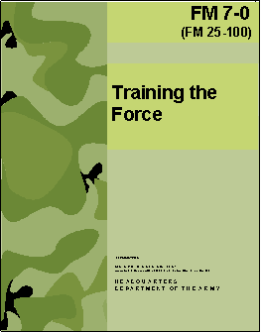
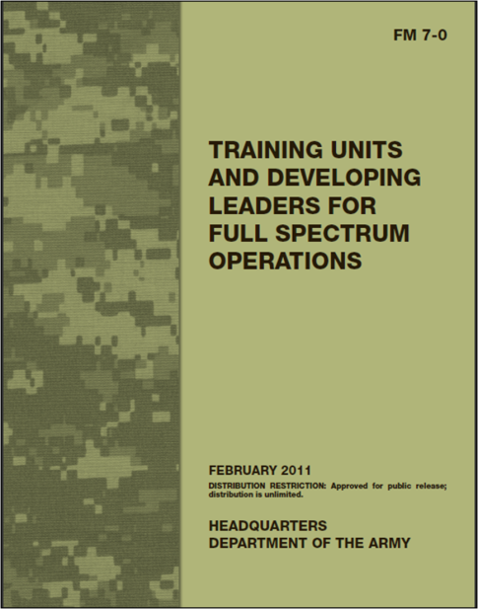
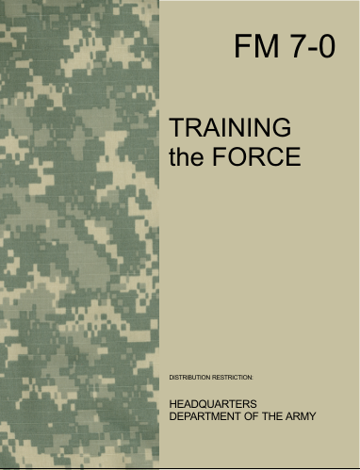

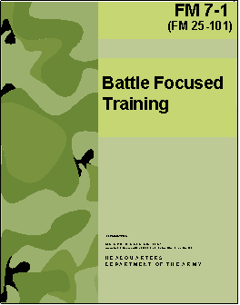

FM 7-0, Training Units and Developing Leaders
For Full Spectrum Operations
(Feb 11)
Keystone Training Doctrine
Applies to the entire Army
Reduced in the size
Focuses on:
-Complex OE
-Principles of Unit Training
-Principles of Leader Development
-Training Management
Moves “How To…” Techniques, & Procedures
to ATN
Updated
The ‘What’ of Training
TRAINING FOR FULL SPECTRUM OPERATIONS
Best used on or ICW ATN
122 pages
62 pages
Techniques
& Procedures
Doctrine
Examples
Best practices
Easily updated
Collaboratively
reviewed, as needed
Solutions to
training challenges
The ‘How To’ of Training
243 pages
Notes:
TAKEAWAYS:
Significant change from previous update
This update will focus 7-0 on “What” and 7-1 on “How-to”
FM 7-1 will become VFM 7-1 – Army’s first web-based FM
ISSUES:
None
The next few slides provide an overview of the Army’s keystone training doctrine, FM 7-0, and the big ideas and/or changes in the manual since the 2008 version was last published.
This slide provides a snapshot of the guidance originally given to revise the Army’s training doctrine before the 2008 version up through and including the present 2011 version.
The 2011 version of FM 7-0 represents the 4th edition of the Army’s training doctrine. The title changed from “Training for Full Spectrum Operations” to “Training for Full Spectrum Operations.” It contains the “what” of Army training – the basic fundamentals, principles and guidelines -necessary to describe what leaders need to do to plan, develop and execute training. Fundamentals, principles and guidelines are more permanent and enduring; less prone to revision than techniques and procedures (TTPs if you will) which makes FM 7-0 an appropriate manual for the Army to publish in hard/print copy in this time of cost savings and emphasis on the use of technology.
The Army published the first edition of this manual in 1988 as FM 25-00, Training the Force. It was renumbered as FM 7-0, Training the Force, during its first rewrite in 2002 and retitled during the second revision/rewrite in 2008 This version of FM 7-0 continues to emphasize the need to change the Army mindset toward training and that training today’s is vastly different from pre-9-11 training.

Slide 5
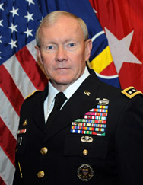
FM 7-0 Forward
TRADOC Commander and the 37th Army Chief of Staff!
There are several things I believe about training:
Everything we do has training value.
Time is the scarcest resource we confront in training.
The best trained units determine which limited
number of training tasks they intend to master and then adapt from that known point as conditions
change.
Good leaders take pride in planning,
preparing, executing, and assessing training.
Training has to be credible, relevant, and
rigorous to “make the scrimmage as hard
as the game.”

Slide 6
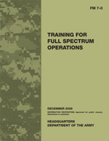
Synopsis of Changes
(1 of 2)
New Title
Adds emphasis on
Leader Development,
planned concurrently
with unit training
Best viewed on
2008
2011
73 content pages
CMETL/DMETL
C2/Battle Command
Traditional &
Irregular Threats
Principles of Training (7)
25 content pages
FSO METL
Mission Command
Hybrid Threats
Principles of Training (11)
Principles of Leader Development (7)
Unit Leader Development Planning
Condensed
Replaced
Updated
Updated
Expanded
Added
Notes:
This slide offers a snap-shot of what you’ll find immediately different between the 2008 version and the 2011 versions of FM 7-0.
The first thing you’ll notice is the new title, a change reflecting the inclusion of “developing leaders” or “leader development” as a planned part of unit training management. We’ve always done this in units, but we’ve never thought much about the process of how leaders plan, prepare, execute and assess the development of junior leaders - as units train. This change emphasizes that commanders can use FM 7-0 to train units and develop leaders.
This version of FM 7-0 is far more concise than previous versions. The CSA wanted us to move FM 7-0 to a higher, intellectual level and not get bogged down with the details. This version provides a sound and reliable framework for the ‘what’ of training and links that content to the details and examples that are available on ATN. This keeps the doctrine much more enduring, while allowing us to update the details as the Army changes – without waiting for the doctrine to catch-up, sometimes years later.
The Core METL (CMETL) and Directed METL (DMETL) construct was eliminated in 2009 shortly after the 2008 publication of FM 7-0; this version of the manual codifies that change, replacing these terms with simply the concept of a “Full Spectrum Operations Mission-Essential Task List (FSO METL)” some of which are standardized for brigade and higher units.
The manual integrates the concepts of mission mommand, combined arms maneuver and wide area security. The authors of FM 7-0 ensured that as FM 3-0, Operations, FM 5-0, The Operations Process, and FM 6-0, Mission Command: Command and Control of Army Forces, continue to evolve, that the Army’s training doctrine evolves right along with these important capstone and keystone manuals. For instance, the change from the command and control (C2) and Battle Command concepts to “Mission Command” in FM 3-0 C1 is also reflected in this rewrite and publication of FM 7-0
This version of the manual/doctrine expands the Principles of Unit Training and have also includes the addition of new principles – the principles of leader development.
Perhaps one of the biggest, fundamental change to the manual is that the best way to read and view FM 7-0 is on ATN. What makes this a better experience than reading just the doctrine – Soldiers can also quickly and easily get to expanded discussions on Training Management and view actual examples like videos on “how to” conduct a company-level training meeting, and much more – from one central location – ATN.
Focuses on a modular, brigade-centric force in the ARFORGEN process
Introduces the importance of FSO training against complex hybrid threats.
Includes the concept that training oversight is a collaborative process between the losing and gaining commanders.
Describes the Training Management Process as an intellectual process that employs the mission command concept, rather than prescribed step-by-step

Slide 7
Synopsis of Changes
(2 of 2)
All extraneous verbiage, discussion and/or examples eliminated or moved to the TM link of ATN
Eliminates the term “Crawl, Walk and Run” but maintains this training concept through the ARFORGEN process which emphasizes progressive readiness over time while leveraging the experience of the Army’s “Combat Seasoned Force”
Modifies discussion of Long and Short Range Planning and eliminates Near Term Planning
and 6-8 week lock-in;
Eliminates the term “Near Term Planning” and replace “Training Schedules” with “Unit Training and Leader Development Schedules” which normally covers one week timeframe
Commanders empowered; they determine how far out schedules are published and the training lock-in timeframe
Not mentioned but still valid: Mission Focus process (replaced Battle Focus in 2008); Top-Down/Bottom-Up approach; Joint METL (JMETL); Training Strategy (based in CATS); Army Training System (AR 350-1)
Notes:
The manual is much more concise with no extraneous verbiage. All “how to…” has been removed to ATN to include lengthy explanations, examples, etc.
This manual eliminates the term and concept as we knew it of “Crawl-Walk-Run” which is replaced in essence by the ARFORGEN which emphasizes achieving progressive readiness over time while leveraging the experience of a “Combat Seasoned Force.”
Modifies discussion of Long and Short Range Planning and eliminates Near Term Planning and 6-8 week lock-in;
Eliminates the term “Near term Planning” and replaces “Training Schedules” with “Unit Training and Leader Development Schedules” which normally covers one week timeframe
Commanders are further empowered (carrying on the effort started with the revision in 2008 to give commanders more flexibility with ARFORGEN); Commanders determine how far out schedules are published and what the training lock-in timeframe is they want to adhere too.
Not specifically mentioned in the manual or mentioned in name/title only but still considered valid training concepts are:
--Mission Focus process (replaced Battle Focus in 2008)
--Top-Down/Bottom-Up approach to training
--Joint METL (JMETL)
--Training Strategy (based in CATS)
--Army Training System (AR 350-1); served as the genesis for the old chapter 2 (2008 manual)
Includes the concept that training oversight is a collaborative process between the losing and gaining commanders.
Describes the Training Management Process as an intellectual process that employs the mission command concept, rather than prescribing how leaders train step-by-step

Slide 8

Contents of the New FM 7-0
Chapter 1: Training for Complex
Operational Environments
Future Challenges
Capability for FSO
Characteristics of:
Complex OE
Hybrid Threat
Mission Command and Training for FSO
Training to Ensure Operational Adaptability
Intellectual
Discussion
Generate
Introspection
Chapter 2: Principles of Unit Training and Leader Development
Training Concept
Presentation of the Army’s
11 Principles of Unit Training; and
7 Principles of Leader Development
Training Domains
  Institutional
  Operational
  Self-development
Army Training and Leader
Development Model
Just
Enough
Guidance
Chapter 3: Army Training Management
Army Training Management Model
  Prepare
  Plan
  Execute
  Assess
  Commander’s Role in Training
  Reserve Component Training Responsibilities
  Training Units in ARFORGEN
  Long and Short-Range Planning
  Assessments
Condensed
Just
25 pages of
Content
8
Notes:
This slide provides an overview of the contents of the 2011 training manual/doctrine by chapter.
As a result of further revision the manual shrunk from 60 pages to just 25 pages focused content that addresses only those enduring concepts and principles that continue to serve the Army so well and change very little over time.
This slide gives you an overview of the contents of the manual by chapter. Keep in mind that the CSA asked directed that FM 7-0 be written at a more intellectual, conceptual level to make it more enduring resulting in a much more concise manual that is easy, quick to read. The nuts-and-bolts of the details on “how to” train, examples and more detailed explanations have been moved to the Army Training Network (ATN).
For starters, the manual was further reduced from 4 to just 3 chapters that focus solely on the “what” of training – the broad, basic foundations and enduring principles of training and training management that leader need to “train toward” in order to achieve success in the current and future operational environments (OE).
Chapter 1, Training for Complex Operational Environments, describes training to ensure forces are ready for the complexities of the operational environments, to include “Hybrid Threats” that Soldiers, leaders and units are likely to face in the future. It also discusses how training ensures Soldiers and leaders are operationally adaptable.
Chapter 2, Principles of Unit Training and Leader Development, discusses the Army’s approach to unit training and leader development. It explains the principles of unit training and leader development that serve as the foundation for Army training.
Chapter 3, Army Training Management, discusses the Army’s model for training management, which is derived from the operations process. It explains planning, preparation, execution, and assessment of training.

Slide 9
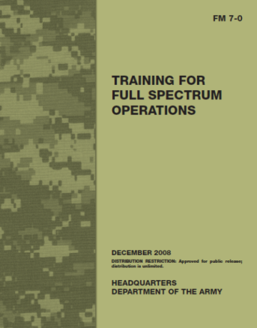
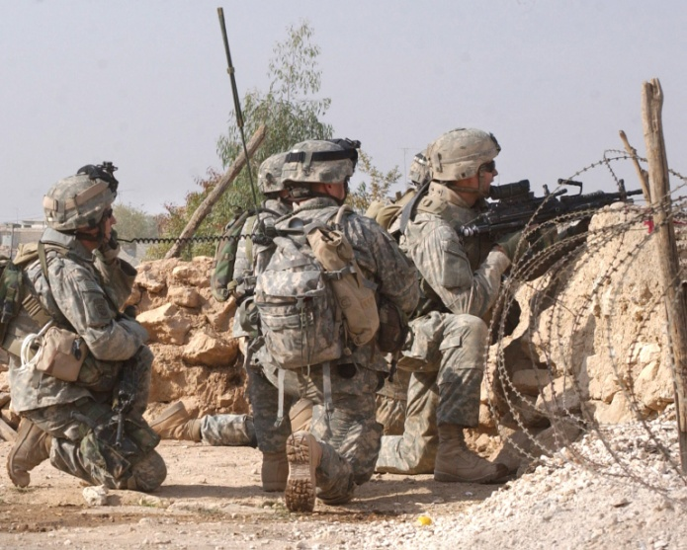
Training for Complex
Operational Environments
    Training To Ensure Forces Are Ready
    Capability For Full Spectrum Operations
    Capability For Full Spectrum Operations
    Characteristics Of Threats
    “Hybrid Threat”
    Mission Command And Training For Full Spectrum
    Operations
    Training To Ensure
    Operational Adaptability
    --Shape conditions
    --Respond effectively
    --Anticipate change
    --Identify opportunities
    --Take prudent risks
Chapter 1
MUST TRAIN TO RECOGNIZE AND SOLVE COMPLEX,
ILL-DEFINED PROBLEMS QUICKLY!
Notes:
Chapter 1, titled Training for Complex Operational Environments, describes training to ensure forces are ready for the complexities of the operational environments they are likely to face. It also discusses how training ensures Soldiers and leaders are operationally adaptable.
This version of the manual continues to emphasize that the Army must change the Army mindset in training; there can be no return to the pre-9-11 mindset where training focused solely on offense and defense in major combat operations (MCO) but instead, training must focus on conducting full spectrum (simultaneous combinations of offense, defense and stability or civil support) operations across the spectrum of conflict in a complex OE characterized by rapidly changing conditions and a “hybrid” threat.
New Soldiers and civilians entering the Army each year and the nature of Army force generation (ARFORGEN) require unit training and leader development principles that ensure units and leaders are mission-ready
Army units face challenging operational environments. Numerous factors shape them, such as scientific advances, information technology, transportation, economic globalization, and the Internet, which increase the uncertainty and complexity of operational environments.
Army units conduct full spectrum operations by combining offensive, defensive, and stability or civil support operations simultaneously as part of an interdependent joint force to seize, retain, and exploit the initiative, accepting prudent risk to create opportunities to achieve decisive results
Training must account for the environment of each operation.
Operational environments remain:
--chaotic, complex, and uncertain; may be foreign or domestic with operations conducted among the people.
--dynamic with Joint, interagency, intergovernmental, and multinational partners among the wide range of actors in addition to coalitions, alliances, and partnerships.
State and nonstate actors use military and nonmilitary resources, including diplomatic, informational, military, and economic measures
International news organizations, using the latest technologies, provide real-time reports from the area of operations (AO)
Cultural, demographic, and physical factors, including humanitarian crises and ethnic and religious conflicts, continue to fuel existing conflicts and spark deadly new clashes. Urban terrain and other complex terrain become havens for threats.
Effective mission command requires Soldiers and leaders trained to operate in ill-defined, ambiguous conditions.
Operational adaptability is the ability to shape conditions and respond effectively to a changing operational environment with appropriate, flexible, and timely actions (FM 3-0). Army forces must be adaptable so they can react quickly to myriad hybrid threats and conduct different operations simultaneously. Leaders and units will face complex and constantly changing environments and must train to recognize and solve complex, ill-defined problems quickly. Training must prepare units and leaders to anticipate change, identify opportunities, and take prudent risks within the commander’s intent. Army training prepares units and leaders to do this through tough, realistic full spectrum operations training at home station, at the combat training centers, and in the schoolhouses.

Slide 10
Principles of Unit Training and
Leader Development
(1 of 4)
Army Approach To Unit Training and Leader Development
Presentation of the Army’s
Principles of Unit Training
Principles of Leader Development
The Army Training Domains
  Institutional
  Operational
  Self-development
The Army Leader Development Model
Chapter 2

Slide 11
Principles of Unit Training and
Leader Development
(2 of 4)
    The Army’s 11 Principles of Unit Training:
      Commanders and other leaders are responsible for training
      Noncommissioned officers train individuals, crews, and small teams
      Train to standard
      Train as you will fight
      Train while operating
      Train fundamentals first
      Train to develop operational adaptability
      Understand the operational environment
      Train to sustain
      Train to maintain
      Conduct multiechelon and concurrent training.
Chapter 2
Notes:
FM 7-0: 2011, Chapter 2 discusses the Army’s approach to unit training and leader development. It explains the principles of unit training and leader development that serve as the foundation for Army training. The slide depicts the “Principles of Unit Training “ which changed from 7 to 11 and the “tenets” added in the 2008 version which helped explain each principle were eliminated.

Slide 12
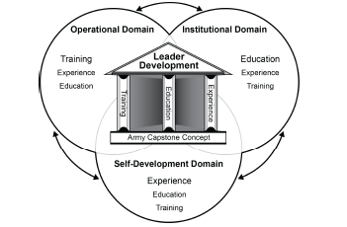
Principles of Unit Training and
Leader Development
(3 of 4)
Leader Development is
deliberate, continuous, and
progressive over a leader’s
entire career
Leader Development comprises:
Training and education in schools
Learning and experiences in units
Self-development by individual
Training domain is a sphere of learning
Each domain encompasses training, education and experience
Three training domains (Institutional, Operational, and Self-Development) are inextricably linked and complement each other.
All three domains working together provide synergistic system of training and education.
Leader Development of subordinates is every leaders top priority!
Chapter 2
    The Army’s Leader Development Model
Notes:
In the past, the Army never tied leader development directly to our training doctrine. FM 6-22 (Army Leadership) does a tremendous job in covering what Army leadership is, but fails to address how a leader plans and executes the leader development of junior leaders while his units are training. With the addition of these principles, this version of FM 7-0 has begun this task of integrating leader development into our training doctrine as a vital piece of unit training.
Soldiers and Army civilians begin training the day they enter the Army. They continue training until the day they retire or separate. Individuals train to build the skills and knowledge essential to a trained, expeditionary Army. Training prepares individuals, units, staffs, and their leaders to conduct full spectrum operations anytime and anywhere along the spectrum of conflict. This lifelong learning occurs in all three training domains—institutional, operational, and self-development—and involves self-assessment. Developing agile, expeditionary leaders requires that the three training domains complement each other. Training, education, and leader development are inextricably linked. The generating force must expand its focus beyond the institution to support the operating force as leaders and units prepare for deployments.
Institutional. Soldier training begins in the generating force (schools and training centers). Soldiers train on individual tasks that ultimately support their projected unit’s core capability mission-essential tasks. Soldiers train on warrior tasks—critical tasks that all Soldiers must perform in full spectrum operations. Armed with basic skills from the institution, Soldiers are assigned to a unit. There they integrate into a team and begin training in the operational training domain.
Operational. Operational assignments build on the foundation of individual skills learned in schools. Unit leaders introduce new skills required by a Soldier’s specialty. In addition, Soldiers master collective tasks that support the unit’s mission-essential tasks.
Self-Development. Self-development is just as important as other individual training. It allows individuals to expand their knowledge and experience to supplement training in the institutional or operational training domains. Self-development can enhance skills needed for a current position or help prepare an individual for future positions.

Slide 13
Principles of Unit Training and
Leader Development
(4 of 4)
    The Army’s 7 Principles of Leader Development:
      Lead by example.
      Take responsibility for developing subordinate leaders.
      Create a learning environment for subordinate leaders.
      Train leaders in the art and science of mission command.
      Train to develop adaptive leaders.
      Train leaders to think critically and creatively.
      Train your leaders to know their subordinates and their families.
Chapter 2
FM 7-0, Training for Full Spectrum Operations, Dec 08, Table 2-1
Notes:
Instructor note: This slide depicts the “Principles of Leader Development” added in this revision of the manual. Many of these items located here were espoused in the last version of the manual but not all grouped together ,as they are now, or listed as “Leader Development” principles.
Lead By Example. Leaders are role models. They demonstrate good leadership is to teach good leadership. Everything a leader does and says is scrutinized, analyzed, and often imitated. The example set by leaders influences the thoughts and attitudes of their subordinates, their families, and their peers. A good example positively influences the development of subordinates.
Take Responsibility For Developing Subordinate Leaders. Leaders take responsibility for developing their subordinate leaders. Directly observe, assess and provide honest informal and formal feedback to subordinates. Discuss ways to sustain and improve leader skills, knowledge, abilities, and behaviors with subordinate leaders. Ensure subordinates undergo experiences that enhance their skills, knowledge, abilities, and behaviors; prepare them for success; improve their adaptability; and prepare them for future responsibilities. They ensure their subordinates attend PME at the right time. They counsel, coach, teach, and in some cases, mentor.
Create A Learning Environment For Subordinate Leaders. Growth occurs best in environments that provide subordinates with opportunities to overcome obstacles and make difficult decisions. Leaders encourage their subordinates to seek challenging assignments, and leaders underwrite subordinates’ honest mistakes. Leaders learn in an environment conducive to growth. Learning comes from both successes and failures. Leaders must feel comfortable taking risks and trying new approaches to training. An environment that allows subordinate leaders to make honest—as opposed to repeated or careless—mistakes without prejudice is essential to leader development. Leaders must be adept at self-assessments and AARs to facilitate such development. Leaders must be willing to accept constructive criticism from not only their leaders but also their peers and subordinates. Ideally, leaders learn first through honest self-assessments.
Train Leaders In The Exercise Of Mission Command. Leaders approach mission command training from two perspectives. First, they train themselves and their subordinates on how to conduct operations using mission command as addressed in FM 3-0 and FM 6-0, Mission Command: Command and Control of Army Forces. Second, they follow the principles of mission command in training management. Specifically, they tell their subordinates the purpose for training and the end state they expect from it, but they leave the determination of how to achieve the end state to the subordinate. As appropriate, they provide guidance requested by the subordinate leader. Employing mission command in training follows the principle of “train as you will fight.” Using mission command principles improves not only mission command skills, but it also encourages risk-taking, initiative, and creativity.
Train To Develop Adaptive Leaders. The Army continues to succeed under the most challenging conditions because Soldiers and Army civilians adapt to unexpected situations. Operational adaptability begins in the schools and is then put into practice during tough, realistic training situations—well before leaders are engaged in full spectrum operations. Knowing that change will occur, effective leaders plan for it and develop potential contingency plans to mitigate the effects of change. Effective leaders also look for indicators that change is about to occur so they can ease the transition effects. Placing subordinate leaders into changing, unfamiliar, and uncomfortable situations in training helps foster operational adaptability. The lessons they learn help develop intuition, confidence, and the ability to “think on their feet. The Army trains leaders for their next position before they assume it. Cross-training provides unit depth and flexibility and builds leader confidence.
Train Leaders To Think Critically And Creatively. Critical and creative thinkers:
• Are open-minded and consider alternative, sometimes non-conformist, solutions and the second and third order effects of those solutions.
• Collaborate with other unit members for help in analyzing and red-teaming solutions.
• Make timely, informed decisions.
• Are adept at honestly assessing their own strengths and weaknesses, and self-prescribing ways to sustain strengths and overcome weaknesses.
The Army develops leaders able to solve difficult, complex problems. Leaders should be able to recognize the issue, quickly ask the right questions, consider a variety of alternative solutions, and develop effective solutions. They should be comfortable making decisions with minimal information. Army leaders employ the design methodology described in FM 5-0, The Operations Process.
Train Leaders To Know Their Subordinates And Their Families. Every leader should know his or her subordinates at least two levels down—their strengths, weakness, and capabilities. An effective leader maximizes a subordinate’s strengths and helps him or her overcome weaknesses. Similarly, an effective leader provides advice, counsel, and support as subordinate leaders develop their own subordinates. Family well-being is essential to unit and individual readiness. The Army trains leaders to know and help not only the subordinates, but also their families. Training ensures subordinate leaders recognize the importance of families and are adept at helping individuals solve family issues and sustain sound relationships

Slide 14
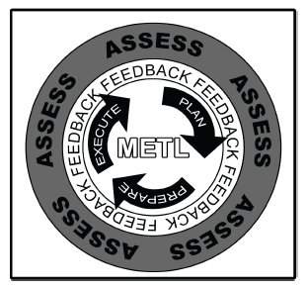
Army Training Management
    The Army Training Management
    Model.
    Commander’s Role in Training
    Reserve Component Training
    Responsibilities
    Training Units in Army Force Generation (ARFORGEN)
    Force Pools
    Training Supervision
    Training Units Not In ARFORGEN Force Pools
    Plan
    Prepare (added in 2008 version)
    Execute
    Assess
Chapter 3
FM 7-0, Training for Full Spectrum Operations, Dec 08, pp 3-4 and 3-5.
Notes:
Chapter 3, titled Army Training Management, discusses the Army’s model for training management, The Army Training Management Model, which is derived from the operations process. It explains planning, preparation, execution, and assessment of training.
Ask the students: What is the Army training management? The process used by Army leaders to identify training requirements and subsequently plan, prepare, execute, and assess training. Army training management provides a systematic way of managing time and resources and of meeting training objectives through purposeful training activities.
The foundation of Army training is the Army training management model highlighted by the red box around it on the right hand side of the slide. This model provides the framework commanders use to achieve proficiency during training in their unit’s mission-essential tasks. The training management model was changed in the 2008 version of FM 7-0 to mirror the Army’s Operations Process described in FM 3-0 of plan, prepare, and execute with continuous assessment. However, there are two primary differences between the two: First, while Mission Command drives the operations process, the METL drives training management (note METL in the middle of the model). And second, the training management model includes bottom-up feedback to support the commanders’ assessments. While each of the model’s activities is important, successful training largely results from thorough preparation.

Slide 15
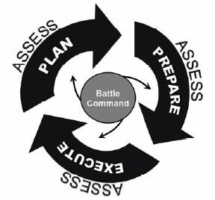
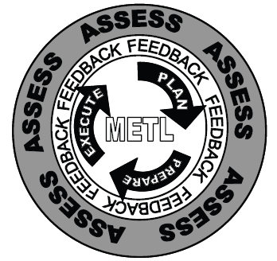
Army Training Management Model
The foundation of Army training is the Army training management model. This model mirrors the operations process described in FM 3-0, Operations (Feb 08).
There are two primary differences between the two:
  First, while battle command drives the operations process, the METL drives training management.
  Second, the training management model includes bottom-up feedback to support commanders’ assessments.
Operations Process Model
Training Management Model
FM 3-0, Operations, Feb 08, Fig 5-3, p. 5-16
FM 7-0, Training Units and Leader Development for FSO, Feb 11, Fig 3-1, p. 3-1
      Train As You Will Fight!
Notes:
The foundation of Army training is the Army training management model highlighted by the red box around it on the right hand side of the slide. (See figure 4-5, FM 7-0) This model provides the framework commanders use to achieve proficiency during training in their unit’s mission-essential tasks. The training management model was changed to mirror the operations process described in FM 3-0 of plan, prepare, and execute with continuous assessment. However, there are two primary differences between the two: First, while battle command drives the operations process, the METL drives training management. And second, the training management model includes bottom-up feedback to support commanders’ assessments. While each of the model’s activities is important, successful training largely results from thorough preparation.
Conducting training to standard begins with planning. Units develop training plans that enable them to attain proficiency in the mission-essential tasks needed to conduct full spectrum operations under conditions in likely operational environments. Commanders determine a training strategy for the unit and prepare training plans. Developing these plans involves identifying and scheduling training events, allocating time and resources, and coordinating installation support. Commanders perform long-range, short-range, and near-term planning. They present a training briefing to their higher commander to obtain approval of their long- and short-range plans. Commanders also request approval of the commander-selected collective tasks that support the METL during this briefing.

Slide 16
Army Training Management Model
Plan
Prepare
Execute
Assess
Notes:
Training management is the process used by Army leaders to identify training requirements and to subsequently plan, prepare, execute, and assess training.
Conducting training to standard begins with planning. Units develop training plans that enable them to attain proficiency in the mission-essential tasks needed to conduct full spectrum operations under conditions in likely operational environments. Commanders determine a training strategy for the unit and prepare training plans. Developing these plans involves identifying and scheduling training events, allocating time and resources, and coordinating installation support. Commanders perform long-range, short-range, and near-term planning. They present a training briefing to their higher commander to obtain approval of their long- and short-range plans. Commanders also request approval of the commander-selected collective tasks that support the METL during this briefing.

Slide 17
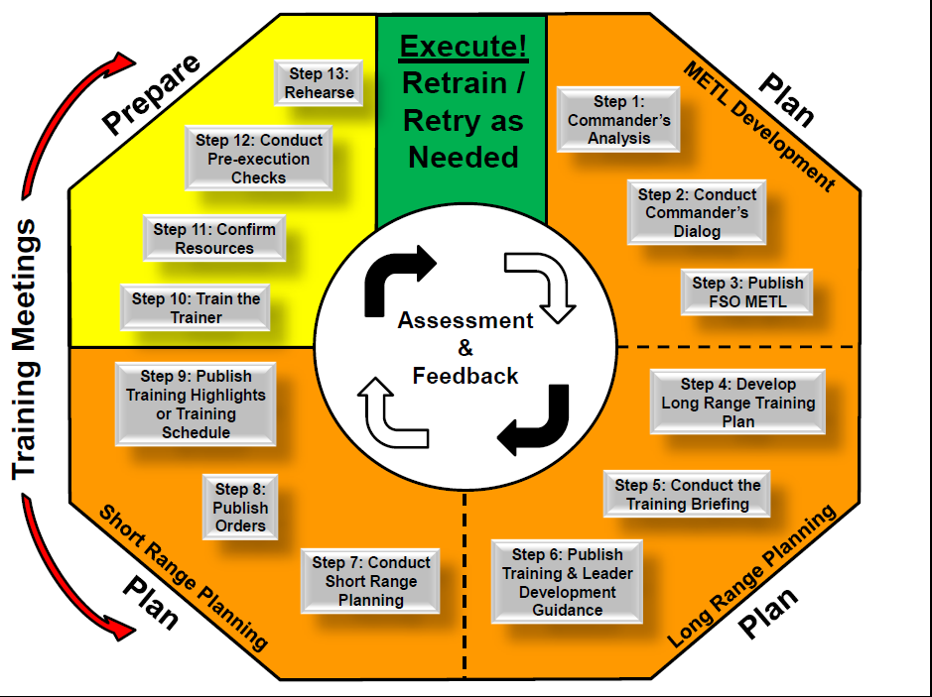
Training Management Process Wheel
Notes:
The Training Management Process Wheel. Developed at CTD/CAC-T the wheel offers a way to graphically depict some of the major activities and steps involved in the training management process.

Slide 18
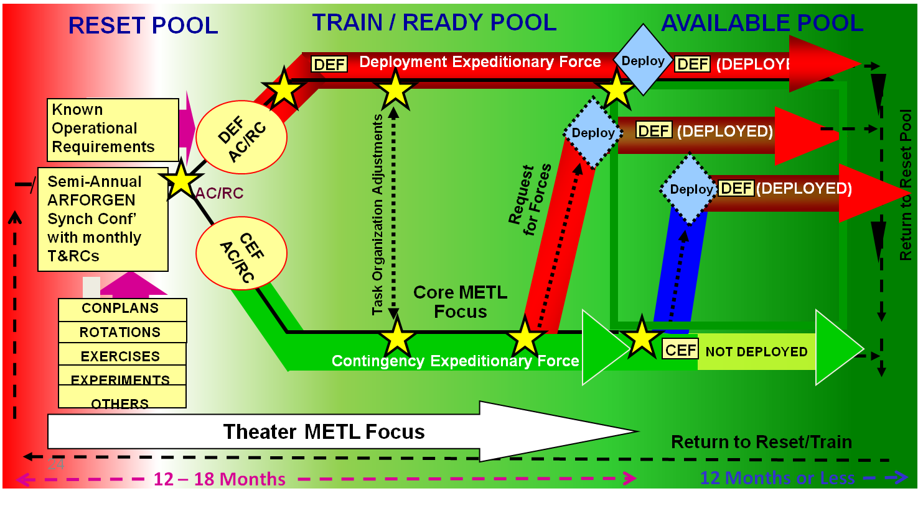
Army Training Management
    Army Force Generation (ARFORGEN). Process for building a unit’s capability to conduct full spectrum operations over time; progressive; drives training management. Consists of three major phases/force pools:
    Reset Phase/Force Pool
    Train/Ready Phase/Force Pool
    Available Phase/Force Pool
Chapter 3
Each have different unit training and leader development requirements, manning and equipping objectives, degrees of decentralization, and readiness goals.
FM 7-0, Training for Full Spectrum Operations, Dec 08, pp 3-4 and 3-5.
Notes:
Chapter 3, titled Army Training Management, discusses the Army’s model for training management, The Army Training Management Model, which is derived from the operations process. It explains planning, preparation, execution, and assessment of training.
What is the Army training management? The process used by Army leaders to identify training requirements and subsequently plan, prepare, execute, and assess training. Army training management provides a systematic way of managing time and resources and of meeting training objectives through purposeful training activities.
The foundation of Army training is the Army training management model highlighted by the red box around it on the right hand side of the slide. This model provides the framework commanders use to achieve proficiency during training in their unit’s mission-essential tasks. The training management model was changed in the 2008 version of FM 7-0 to mirror the Army’s Operations Process described in FM 3-0 of plan, prepare, and execute with continuous assessment. However, there are two primary differences between the two: First, while Mission Command drives the operations process, the METL drives training management (note METL in the middle of the model). And second, the training management model includes bottom-up feedback to support the commanders’ assessments. While each of the model’s activities is important, successful training largely results from thorough preparation.
What impact has the ARFORGEN had on training? The Army prepares and provides campaign capable, expeditionary forces through ARFORGEN. ARFORGEN applies to Regular Army and Reserve Component (Army National Guard and U.S. Army Reserve) units. It is a process that progressively builds unit readiness over time during predictable periods of availability to provide trained, ready, and cohesive units prepared for operational deployments. ARFORGEN takes each unit through a three-phased readiness cycle: reset, train/ready, and available. Both the generating force and the operational Army participate in and respond to ARFORGEN. The generating force supports operational Army training. Operational Army commanders develop plans for training mission-essential tasks. Commanders prioritize resource allocation based on the following factors: time available, training time required, resource availability, and the directed mission. The generating force adjusts level of support to meet operational Army requirements.
Under ARFORGEN the way the modular force trains and deploys is different than in the past. In the past, Divisions usually could expect to deploy with only their assigned units. Today, units can come from anywhere. The manual clarifies that a commander having ADCON of a unit is responsible for the training and readiness of it until it is assigned or attached upon deployment (wheels up) to a force package. Until then, Expeditionary Force Package commanders can influence the training of the units that will deploy with them through the process of collaboration.

Slide 19
ARFORGEN Model
Progressive, cyclical readiness – Requirements Driven – Capabilities based
Validated Requirements
Trained & Ready
Modular Capabilities
Sourcing
Resourcing
RESET POOL
TRAIN / READY POOL
AVAILABLE POOL
DEF
Deployment Expeditionary Force
Deploy
DEF (DEPLOYED)
Known
Operational
Requirements
DEF
Deploy
DEF (DEPLOYED)
AC/RC
Semi-Annual
ARFORGEN
Synch Conf’
with monthly
T&RCs
Return to Reset Pool
AC/RC
Request
for Forces
Deploy
(DEPLOYED)
DEF
Task Organization Adjustments
CEF
AC/RC
Core METL
Focus
CONPLANS
ROTATIONS
EXERCISES
EXPERIMENTS
OTHERS
CEF
Contingency Expeditionary Force
NOT DEPLOYED
Theater METL Focus
Return to Reset/Train
12 – 18 Months
12 Months or Less
Notes:
Realize implementation of the ARFORGEN model, as designed, is still in its early stages.
Units in ARFORGEN develop long-range training plans that focus on established readiness aim points such as manning, equipping, and training levels. For ARFORGEN units, the long-range plan covers the period leading up to at least one readiness aim point. DA develops aim points and promulgates them through regulation and policy. However, higher and subordinate commanders collaboratively determine the time line for the subordinate’s long-range plan.
The process progressively builds unit readiness over time during predictable periods of availability to provide trained, ready, and cohesive units prepared for operational deployments.
✓ Reset (Phase) Force Pool: Units enter this phase when they redeploy from long-term operations or complete their planned deployment window in the available force pool.
✓ Train/Ready (Phase) Force Pool: Units move to this phase when they are prepared to conduct higher level collective training and prepare for deployment.
✓ Available (Phase) Force Pool: Forces and headquarters deploying to an ongoing operation or available for immediate alert and deployment to a contingency are in this phase.

Slide 20
Plan
Formal conducted at company level and above; informal platoon and below
Leads to identification of collective and individual tasks to train
Results in collaboration between commander’s and units
Leads to Commander’s Dialogue
Training plans link collective tasks to train and the assessment of proficiency in those tasks to the training events needed to achieve the commander’s visualized end state.
Long-range training plan describes this linkage.
Short-range planning and orders to adapt to changes in the long-range plan.
20
Notes:
20
Planning, the first step in the Army Training Management Model, is the process whereby the staff translates the commander’s vision of full spectrum operations METL proficiency into training events.
Conducting training to standard begins with planning. Units develop training plans that enable them to attain proficiency in the mission-essential tasks needed to conduct full spectrum operations under conditions in likely operational environments. Commanders determine a training strategy for the unit and prepare training plans. Developing these plans involves identifying and scheduling training events, allocating time and resources, and coordinating installation support. Commanders perform long-range and short-range planning. They present a training briefing to their higher commander to obtain approval of their long- and short-range plans. Commanders also request final approval of the commander-selected collective tasks that support the METL agreed upon during the Commander’s Dialogue during this briefing
The commander identifies the required level of full spectrum operations METL proficiency and allocates necessary resources. (See Field Manual (FM) 5-0 for a thorough discussion of planning.)
Training is formally planned at company level and above. Platoons and squads do informal planning to ensure they can execute the long-range training plan.
Leads to identification of collective and individual tasks to train
Results in collaboration between commander’s and units
Leads to Commander’s Dialogue
Training plans link the collective tasks to train and the assessment of proficiency in those tasks to the training events needed to achieve the commander’s visualized end state.
The long-range training plan describes the linkage.
Plans remain flexible as effective leaders expect and anticipate change. They adapt their plans to accommodate changes and mitigate turbulence.
Commanders use short-range planning and orders to adapt to changes in the long-range plan.

Slide 21
Fundamentals of Planning Training
Commanders employ these fundamentals to ensure well-developed training plans that:
Focus on the unit’s FSO METL and supporting collective tasks
Utilize parallel and collaborative planning between echelons of command
Incorporate events that instill adaptability in subordinates
Incorporate habitually task-organized supporting organizations
Incorporate composite risk management (CRM)
Leverage use of training management enablers (e.g. CATS, DTMS, FMs, ARs, etc.)
Allocate, prioritize, and manage resources
Incorporate a combined arms approach, accounting for all warfighting functions (WFF)
Build on previously conducted training; exploit opportunities for multi-echelon training events.
Adjust training event focus based on the assessment of the unit’s current and projected task proficiency
Protect subordinate units from changes once training schedules are published
Allow units to achieve the desired FSO METL proficiency prior to transitioning to the AVAILABLE pool
Notes:
Maintain a Consistent Mission Focus. Each headquarters involves its subordinate headquarters when developing training plans. Based on the higher headquarters’ plans, subordinate commanders prepare plans with a consistent mission focus.
Coordinate with Habitually Task-Organized Supporting Organizations. Commanders of BCTs and battalion task forces plan for coordinated combined arms’ training that includes their habitually supporting organizations. Commanders of other units deploying with BCTs actively participate in developing their supported unit’s training plans and develop complementary training plans. Commanders at all echelons require subordinates to integrate their training plans and monitor coordination efforts during planning.
Focus on the Correct Time Frame. Long-range training plans in the Regular Army and mobilized Reserve Component units extend out at least one year. They may cover an entire ARFORGEN cycle. Reserve Component long-range plans consider a minimum of two years or an entire ARFORGEN cycle. Short-range training plans in the Regular Army and mobilized Reserve Component units normally focus on an upcoming quarter; however, their focus may be dictated by a particular ARFORGEN cycle. Reserve Component short-range training plans typically use a one-year time frame. Near-term planning for the Regular Army and mobilized Reserve Component units starts six to eight weeks before the execution of training; Reserve Component near-term planning starts approximately four months prior. Time frames are flexible and determined between appropriate commanders.
Focus on Organizational Building Blocks. Organizational building blocks include the following:
Individual and small-unit skills.
Leader development.
Battle rosters.
Staff training.
Focus on the Unit’s Mission-Essential and Supporting Tasks. Effective training plans focus on raising or sustaining unit proficiency on mission-essential tasks.
Incorporate Composite Risk Management into All Training Plans. Commanders train their units to tough standards under the most realistic conditions possible. Applying CRM does not detract from this training goal; rather, it enhances execution of highly effective, realistic training. CRM involves identifying, assessing, and controlling risks arising from operational factors and making decisions that balance risk costs with mission training benefits. (See FM 5-19.) Leaders and subordinates at all echelons use CRM to conserve combat power and resources. Leaders and staffs continuously identify hazards and assess risks. Then they develop and coordinate control measures to mitigate or eliminate hazards. CRM is continuous for each mission or training event. It is incorporated into all training plans and is a continuous part of preparation for training.
Lock In Training Plans. Unplanned or unanticipated changes disrupt training and frustrate subordinates. Planning allows organizations to anticipate and incorporate change in a coordinated manner. Stability and predictability can result from locking in training plans. This stability is crucial to training Reserve Component units, where a disruption or delay in training has a significant impact. For instance, a two-hour delay in the start of training during a weekend assembly represents a 12.5-percent loss in available training time. As much as possible, senior commanders protect subordinate organizations from unnecessary changes. Commanders decide the lock-in period for training plans. Nevertheless, change is a part of any operational environment; good organizations adapt to unavoidable changes.
Make the Most Efficient Use of Resources. Time and other training resources are always limited. When allocating them, commanders give priority to the training that contributes most to achieving and sustaining operational proficiency levels.

Slide 22
Full Spectrum Operations
Mission-Essential Task List (METL)
A mission-essential task is a collective task a unit must be able to
perform successfully to accomplish its mission.
Two types of METL: Army “FSO” METL and a Joint METL (JMETL).
A JMETL is a list of tasks that a joint force must be able to perform to accomplish a mission and are described using the common language of the Universal Joint Task List (CJCSM 3500.04E).
Army training doctrine uses “full spectrum operations METL” to add emphasis on FSO
DA standardizes certain unit full spectrum operations METLs
Comprised of FSO METs and Task Groups
FSO METs are derived from unit’s TO&E or TDA missions; Task Groups are a set of
collective tasks to accomplish part of an FSO MET
Next higher commander approves - Commanders’ Dialog
Units cannot train to standard on every task needed for all operations across the spectrum of conflict.
Commanders focus training on the most important tasks through mission focus and the mission-essential task list (METL).
Note: For readiness reporting purposes, FSO METs and task groups do not change,
Notes:
Effective 1 January 2010, non-deployed commanders, in dialogue with their superior commander, will determine the FSO METL supporting tasks and the operational environment on wrlich they will train in their ARFORGEN cycle. The intent is to focus on a few key tasks.
-Commanders with 18 months or less of dwell (RC 36 months) should focus their training and report their readiness for full spectrum operations in their deployed mission environment.
-Commanders with more than 18 months of dwell will be assigned an operational environment for training and reporting their full spectrum readiness by the ASCC Commander until 9 months prior to deployment when ,the deployed mission environment will become the basis for training and readiness reporting.
This guidance is intended to be broad and not restrictive, and it is not intended to limit the commander's discretion or ability to train on anything he or she sees fit.
Joint METL (JMETL): A list of tasks that a joint force must be able to perform to accomplish a mission and are described using the common language of the Universal Joint Task List (CJCSM 3500.04E).
Note that the CSA Army Training and Leader Development Guidance, FY10-11, dtd 31 Jul 09, eliminated the distinction between CMETL and DMETL. Units now simply have one METL focused on conducting full spectrum operations and adjust that METL overtime based on their training assessment or if assigned a mission.
METL also serves as a unifying focus for subordinates and higher units as well. Training the right tasks or METL is extremely important to a unit. It’s the focus of their training and prepares the unit and its Soldiers for wartime missions. There is always too much to be prepared for. Taking the time to analyze all inputs and narrow it down to the essential focus puts the unit on the path to success.
All METL must be approved by higher. This ensures ‘buy in’ from your commander on your focus and forms the basis of a contract
All METL must be nested. Training, whether it is leader, individual, or collective, must be cross-walked to the unit METL. Non-deployed commanders, in dialogue with their superior commander, will determine the FSO METL supporting tasks and the operational environment on which they will train in their ARFORGEN cycle. The intent is to focus on a few key tasks.
What is The Army Training Management Model? The foundation of Army training is the Army training management model which provides the framework commanders use to achieve proficiency during training in their unit’s mission-essential tasks

Slide 23
METL Development
Army
Training and Leader Development Guidance
Higher
Commander
Operations Plans/Orders
DA Approved for
BCT/BDE and Higher
Echelons
Commander’s
Dialogue
FSO
METL
Anticipated Operational Environment
Commander’s Assessment
AdjustedFSO
METL
Training Briefing
Higher
Commander’s Approval
BN and Company
Nested to higher BCT/
BDE
External Guidance
Dialogue with their superior commander, to determine the FSO METL supporting tasks and the operational environment (OE) on which they will train in their ARFORGEN cycle .
Doctrine and Other Publications
ATN
Digital Training Management Strategy (DTMS)
Army Universal Task List (AUTL)
Combined Arms
Training Strategy (CATS)
Notes:
Effective 1 January 2010, non-deployed commanders, in dialogue with their superior commander, will determine the FSO METl supporting tasks and the operational environment on wrlich they will train in their ARFORGEN cycle. The intent is to focus on a few key tasks.
-Commanders with 18 months or less of dwell (RC 36 months) should focus their training and report their readiness for full spectrum operations in their deployed mission environment.
-Commanders with more than 18 months of dwell will be assigned an operational environment for training and reporting their full spectrum readiness by the ASCC Commander until 9 months prior to deployment when ,the deployed mission environment will become the basis for training and readiness reporting.
This guidance is intended to be broad and not restrictive, and it is not intended to limit the commander's discretion or ability to train on anything he or she sees fit.
Instructor note: FM 7-0: 2008, Chapter IV, Army Training Management continued. Discussion points are highlighted below.
Note that the CSA Army Training and Leader Development Guidance, FY10-11, dtd 31 Jul 09, eliminated the distinction between CMETL and DMETL. Units now simply have one METL focused on conducting full spectrum operations and adjust that METL overtime based on their training assessment or if assigned a mission.
METL also serves as a unifying focus for subordinates and higher units as well. Training the right tasks or METL is extremely important to a unit. It’s the focus of their training and prepares the unit and its Soldiers for wartime missions. There is always too much to be prepared for. Taking the time to analyze all inputs and narrow it down to the essential focus puts the unit on the path to success.
All METL must be approved by higher. This ensures ‘buy in’ from your commander on your focus and forms the basis of a contract
All METL must be nested. Training, whether it is leader, individual, or collective, must be cross-walked to the unit METL. Non-deployed commanders, in dialogue with their superior commander, will determine the FSO METL supporting tasks and the operational environment on which they will train in their ARFORGEN cycle. The intent is to focus on a few key tasks.
What is The Army Training Management Model? The foundation of Army training is the Army training management model which provides the framework commanders use to achieve proficiency during training in their unit’s mission-essential tasks

Slide 24
Commanders’ Dialogue
Who:
Commander
Next higher Cdr
Sets & Manages Expectations
What:
Task groups to train
Risks
Conditions to replicate
Resources required
Reset issues
Timeline to achieve CMETL readiness objectives
Readiness assessment
Changing the
Army’s Mindset
Higher level CDR underwrites risk for
what is NOT trained!
How:
One-on-one
In person / VTC / phone
What we are NOT going to train
is just as important as what we train
Why: To get buy-in on training azimuth before training begins
24
Notes:
24
The unit commander and the commander responsible for overseeing training conduct a formal dialog to agree upon expectations for training during ARFORGEN. The commanders’ dialog addresses the results of the unit commander’s mission analysis. Dialogs occur at company level and above. If feasible, the dialog includes the gaining commander if the unit commander is a deployment expeditionary force. For brigades, the dialog includes any units that will be part of the deployment force package.
The purpose of the dialog is to review the collective tasks critical to accomplishing the mission, the conditions for training, and the unit commander’s assessment of proficiency in the collective tasks to be trained. The dialog also covers how all units in the force package, regardless of location or component, will be included in the training plan. Commanders discuss how the gaining commander will be involved in training. The dialog allows commanders to agree on—
● Commanders’ assessment of current full spectrum operations METL proficiency level and projected end state proficiency level.
● Collective tasks to be trained that support the unit’s full spectrum operations METL.
● Risks involved with not training other collective tasks that support the unit’s full spectrum operations METL.
● How the unit training and leader development plans support operational adaptability.
● How the unit will replicate operational environment conditions.
● Any nonstandard or unavailable resources required to replicate the operational environment conditions.
● Significant challenges to readiness.

Slide 25
Training Planning Process
Assessment
METL
Training
Assessment
Training
Strategy
Commander’s
Guidance
Training
Plans
Training
Execution
Feedback
Notes:
Assessment. Training assessments provide focus and direction to planning by identifying training tasks that are new, where performance needs improvement, or where performance needs to be sustained. Training assessments provide commanders with a starting point for describing their training strategy. The training assessment compares the organization’s current level of training proficiency with the desired level of proficiency based on Army standards. This results in training requirements that are necessary to achieve and sustain mission-essential task proficiency. The commander, assisted by key leaders, develops a training strategy that prepares the unit to meet each training requirement
Training Objective. After mission-essential tasks are selected, commanders identify training objectives for each task. A training objective is a statement that describes the desired outcome of a training activity in the unit.
It consists of the task, conditions, and standard:
Task. A clearly defined and measurable activity accomplished by individuals and organizations.
Conditions. Those variables of an operational environment or situation in which a unit, system,
or individual is expected to operate and may affect performance (JP 1-02).
Standard. A quantitative or qualitative measure and criterion for specifying the levels of performance of a task. A measure provides the basis for describing varying levels of task performance. A criterion is the minimum acceptable level of performance associated with a particular measure of task performance. For example, the measure when donning a protective mask is time, and the criterion is a certain number of seconds.
A training strategy describes the ways and means the commander intends to use to achieve and sustain training proficiency on mission-essential tasks. The strategy is based on the commander’s assessment and discussions with the higher commander. Training strategies include the following:
Tasks to be trained.
Training audience.
Training objectives.
Order in which the tasks are to be trained, given limited time and other resources.
Frequency at which tasks are trained.
Types of events used to create conditions for training tasks.
Conditions under which the tasks are to be trained.
Resources required to execute the training strategy.
Alternative ways of training tasks.

Slide 26
Training Planning Process
Training Plans
A training plan translates the CDR’s training and leader development guidance and training strategy into a series of interconnected events to achieve the CDR’s training objectives.
Three types of training plans are:
  Long-range
  Short-range
  Near-term
  Unit Training
  and Leader
  Development
  Schedules
Two
Notes:
A training plan translates the commander’s training and leader development guidance and training strategy into a series of interconnected requirements and events to achieve the commander’s training objectives. Planning documents include the frequency and duration of each training event and the resources required. Required resources and events drive planning considerations. The three types of training plans are long-range, short-range, and near-term.

Slide 27
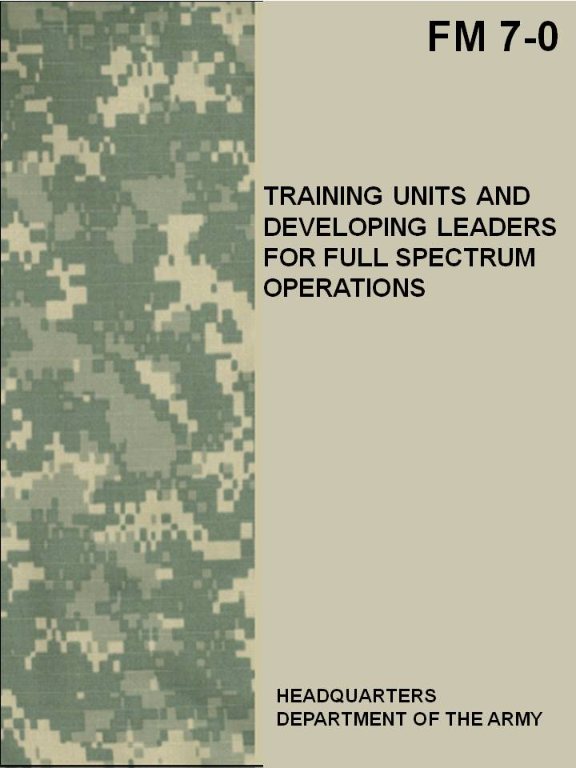
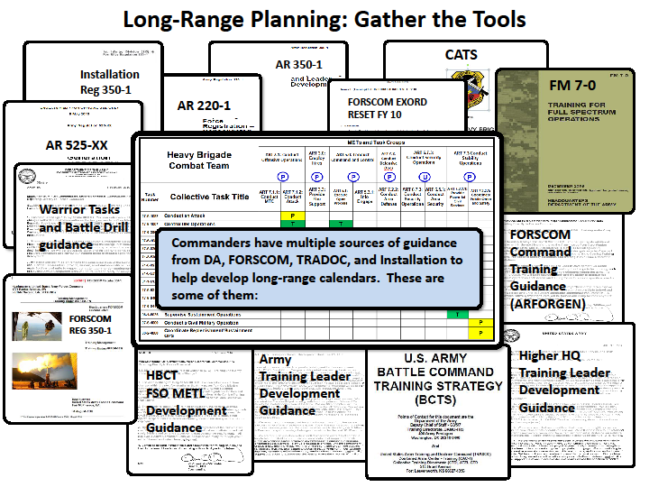
Long Range Planning: Gather the Tools
February 2011
Notes:
Long-range Training Plan. A long-range training plan starts the process of implementing the CDR’s training strategy or Vision. A long-range plan normally covers 12 months for Regular Army and mobilized Reserve Component units. It covers two years to an entire ARFORGEN cycle for other Reserve Component units. However, commanders can adjust the time frame covered to meet their needs. Long-range plans identify the major training events along with the resources required to execute the events.
Identifying the Events to Train Collective Tasks is the Key to Building the Training Plan
The commander analyzes these documents and incorporates the directives and events into their training plan. Although these events are directed the training focus is identified by the commander and based on the “15 Collective Tasks”. These directed events are added to the calendar and form a portion of the training plan.
•The commander identifies additional events to train the HBCT, based the “15 collective tasks”. CATS is a tool to assist the commander with identifying these events, developing a training focus and identifying training gates. These events are also added to the calendar.
•The commander then identifies those levels of task proficiency (training gates) that he deems necessary to accomplish brigade level events. He:
Identifies a training focus based on the 15 collective tasks and adds the event to the calendar.
Directs subordinates to incorporate into their training plan and ensure individuals, section or unit are prepared to execute the training event.

Slide 28
Training Briefings
Commanders present a training briefing to their higher commander to obtain approval of their long- and short-range plans.
The training briefing focuses on two subjects: how the unit commander intends to achieve proficiency on the METL tasks identified during the Commander’s Dialog, and the resources required to do so. Training briefings produce “contracts,” verbal or otherwise, between the higher commander and supporting and subordinate commanders. The contract is an agreement on the following:
    Tasks to be trained.
    Training conditions.
    Resources required to create those conditions.
    Risks associated with where the commanders are focusing training.
Notes:
After the commanders’ dialog and after training plans are developed, commanders provide training briefings to the next higher commander. This interaction between commanders formalizes the training plan and the resources required to accomplish the plan. The training briefing focuses on unit training and leader development plans; it does not cover other administrative matters. Commanders ensure training briefings are concise.
The training briefing is a contract between commanders. The unit commander agrees to train as described in the plan, and the higher commander approves the plan and agrees to provide the resources to execute the plan.
The training briefing includes:
● Assessment of full spectrum operations METL proficiency.
● Collective tasks to be trained in support of full spectrum operations METL proficiency.
● Training events to be conducted and how they incorporate the collective tasks.
● Resources required to replicate operational environments and support execution of training
events.
● Challenges to executing the unit training and leader development plans.
The unit commander publishes the training and leader development guidance (TLDG) for the long-range plan to subordinates after the training briefing is approved.
See next slide for Long-Range and Short-Range training plans.

Slide 29
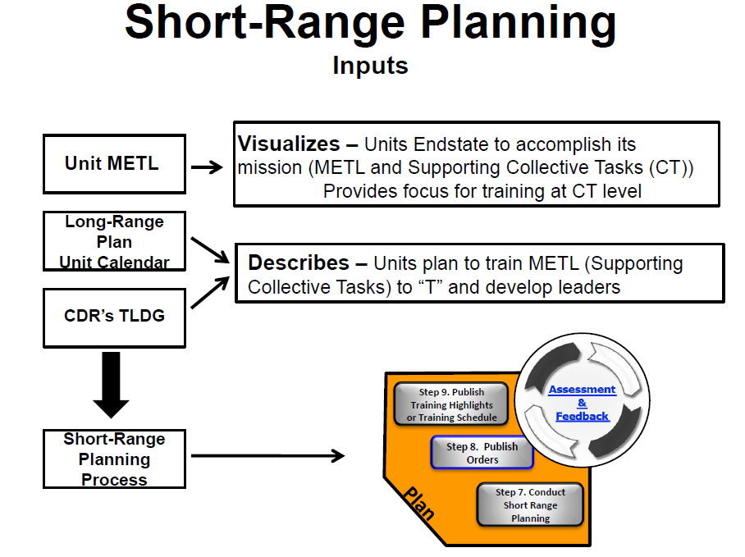
Notes:
A roadmap for attaining proficiency in the collective tasks that support FSO METL, the long-range plan describes the major training events for the unit. Short-range planning provides the details for executing the training events in the long-range plan. The short-range plan can cover months for the Regular Army and even a year for the Reserve Components, but the commander determines the timeframe based on unit requirements.
Short-range planning begins with the commander’s intent and feasible objectives for each training event. The staff and subordinate commanders develop orders that provide the concept of operations and training tasks. Subordinate leaders determine how to achieve the commander’s intent. Leaders ensure resources required for the events are identified, refined, and reserved with the installation and included in the order.

Slide 30
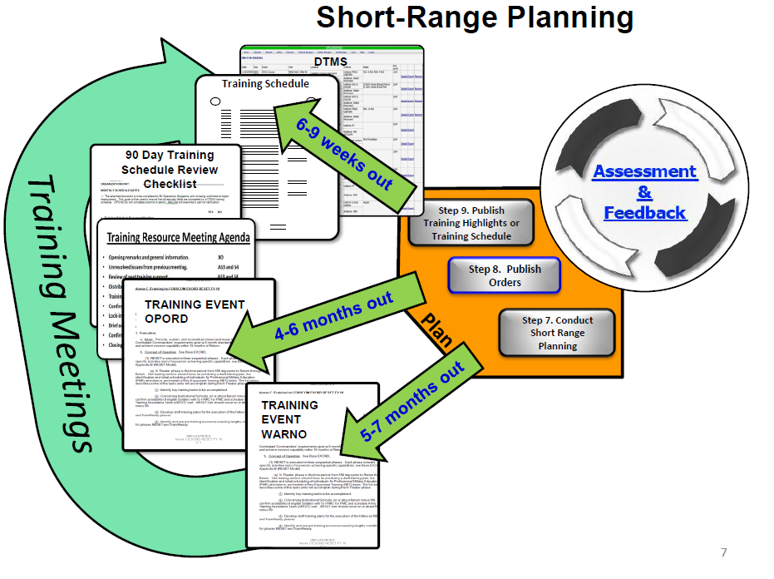
Short-Range Planning
Commanders determine how far in advance Training and Leader Development Schedules are published and locked-in
Unit Training and Leader
Development Schedules
1 Week Out
Unit Training
and
Leader Development
Schedules
Notes:
Short-Range Planning Characteristics . The short range plan results in refined details and proper sequencing required to execute events identified in the long-range plan through:
❑ Detailed resource coordination
❑ Ongoing bottom-up feedback
❑ Published orders to focus planning
❑ Ongoing Parallel/Collaborative planning is
❑ Training schedules/Highlights in DTMS
❑ Routine/productive Training Meetings
❑ Ongoing assessment s (collective and individual task level) of training conducted
❑ Refine and adjust training focus (collective tasks to train)
❑ Use Aim Points to map out FSO METL proficiency in the ARFORGEN cycle

Slide 31
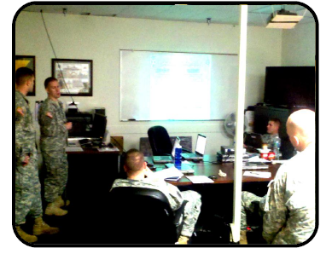
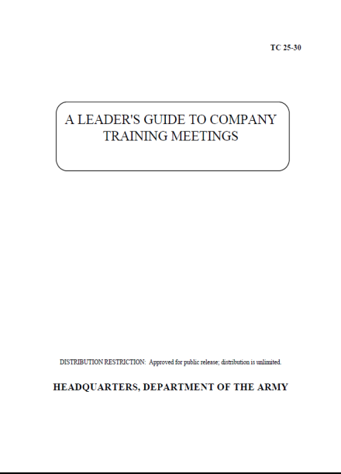
Training Meetings
Successful Training Meetings:
Validate tasks to train for future
events
Synchronize FSO METL with
events
Delegate responsibilities critical
to executing events
Review resource requirements
Ensure cross communication between
leaders
Refine training focus for upcoming events
FM 7-0, Training for Full Spectrum Operations, Dec 08, paras 4-126 thru 130
Notes:
PURPOSE: Training meetings create the bottom-up flow of information about the specific training needs of small-units, staffs, and individual Soldiers. They are the mechanism to guide the execution of the training plan, ensure ongoing cross-communications among commanders and leaders. Training meetings help synchronize the units METL with its training objectives and training events.
ATN has a page is devoted to Training Meetings which contains links to a number of resources currently available for units to plan and execute.
In 1994 the Army published Training Circular TC 25-30, A Leader's Guide to Conducting Training Meetings. Although dated, this TC provides some very useful tips about conducting your own training meeting.

Slide 32
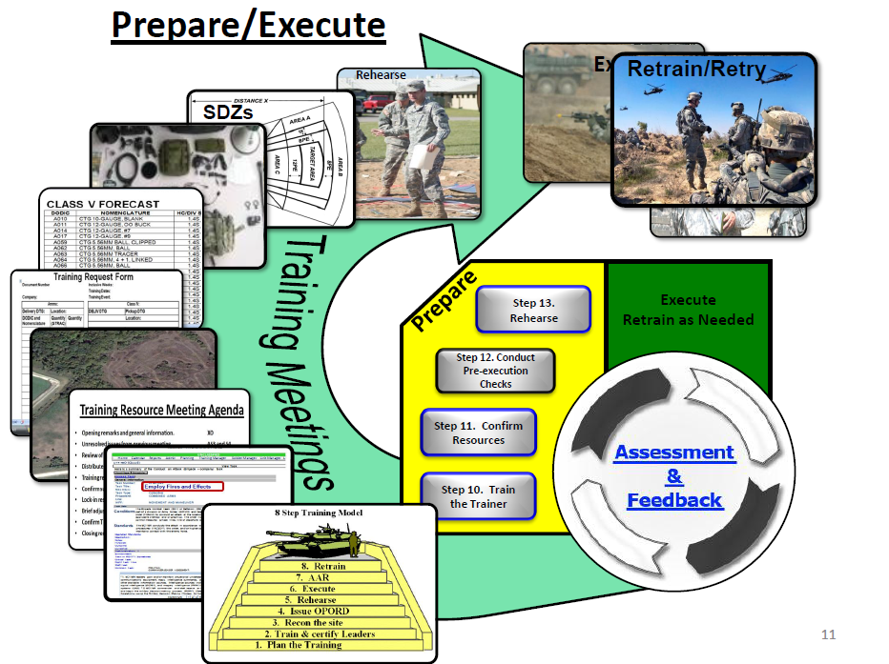
Prepare and Execute

Slide 33
Prepare
Heart of training management
Starts during planning and continues through the completion of each training event
Preparation includes items such as:
  Training the trainers.
  Site reconnaissance.
  Performing rehearsals and pre-execution checks, etc.
Selecting and preparing trainers includes:
  Select, train to standard and rehearse all trainers.
  Ensure that all trainers and evaluators are tactically and technically proficient.
  Creates the conditions for successful execution
  Commanders drive preparation through mission command
33
Notes:
33
Preparation is the heart of training management. It starts during planning and continues through the completion of each training event. It consists of activities units perform to improve their ability to execute each event and thus improve the execution of the Long-Range Plan. A well conducted preparation creates the conditions for successful execution. Commanders drive preparation through mission command. They are always continuing to understand, visualize, describe and direct the training event while leading and assessing their unit. Preparation requires actions from leaders, trainers, and soldiers to ensure that the force is ready to conduct the training.
Preparation helps the unit to transition from planning training to executing training. Preparation activities normally help leaders, trainers, and soldiers to understand the current situation and their role in the upcoming training. The primary functions of preparation in training management include:
Improving situational understanding
Developing a common understanding of the training plan
Identifying subordinate collective, leader, and individual tasks for training events
Ensuring forces and resources are coordinated and positioned at the right place and time for training to begin.
Commanders and other trainers use training meetings to assign responsibility for preparing all scheduled training. Preparation includes the following:
Training the trainers.
Confirming training area availability.
Site reconnaissance.
Continuing CRM.
Ensuring required TADSS availability.
Issuing event training plans.
Performing rehearsals and pre-execution checks.
Continuing to identify and eliminate potential training distracters to maximize training attendance.

Slide 34
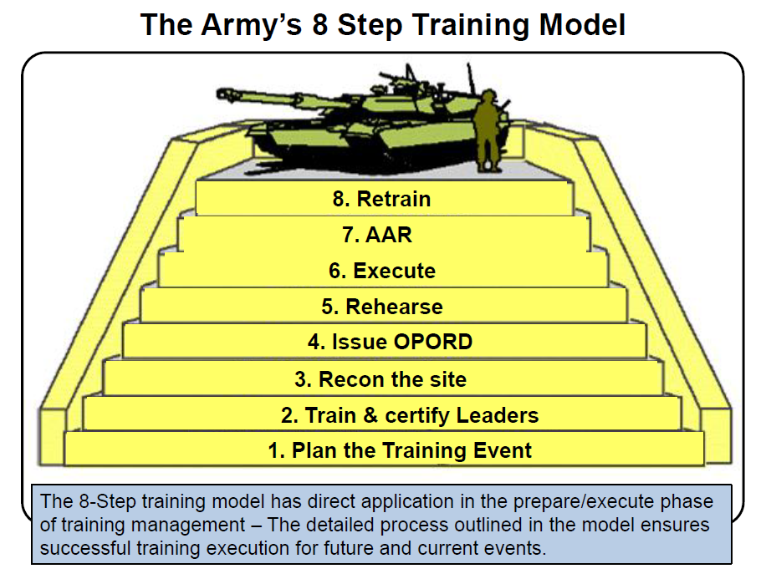
The Army’s 8 Step Training Model
Notes:
Commanders and leaders develop and use training models during short-range planning to ensure the unit achieves the right training focus within the overarching long-range training plan. Training models can help leaders manage training events to maximize event coordination and ensure that tasks are trained to standard. A standard refers to a quantitative or qualitative measure specifying the accepted levels of performance of a task. Models, however, are only aids to planning, preparing, executing and assessing; they are not lock-step processes
Over time, units have developed several models to assist commanders and leaders in planning, preparing, and executing training events. The ‘Eight Step Training Model’ is one of these that have been used by many units and is very effectively at company level and below. When company leaders and trainers apply this, or other unit developed training models for each training event, such as small arms ranges and light scout gunnery, they are able to identify and understand training requirements, leader preparation, and required resources.
The steps of the eight step training model are:
1. Plan the training event
2. Train and certify leaders
3. Recon the training site
4. Issue the OPORD
5. Rehearse the training
6. Execute the training
7. Conduct After Action Reviews
8. Retrain as necessary

Slide 35
Execute
Eliminates term “Crawl, Walk and Run” and establishes Progressive Training!
Characteristics of effective training:
Realism
Safety
Standards-based
Well-structured
Efficient
Challenging
Recovery from training includes:
Performing maintenance training.
Cleaning and accounting for equipment.
Turning in training support items and ammo
Performing final AARs.
Performing final inspections.
35
Notes:
35
Training execution occurs at all echelons. Ideally, training is executed using the crawl-walk-run approach, as appropriate. Effective training possesses the following characteristics:
Realism – Train as you will fight.
Safety – Through CRM, leaders ensure safety is integral and included in every aspect of training—Plan, Prepare, Execute, Assess.
Standards-based – complies with doctrine, does not stifle innovation or prudent risk taking.
Well-structured – contains a mixture of individual and leader tasks in collective tasks.
Efficient – makes the best use of training resources.
Challenging – must be competitive, sometimes against one another and always to achieve the prescribed standard.
Commander’s need to practice Mission Command during execution n training . . . and exercise battle command routinely and frequently. Commanders must exercise mission command in training so that subordinates are used to it and are ready to execute it during actual operations.

Slide 36
Progressive Training
Initial | Intermediate | Advanced
Soldiers - Train each task step. - Train task steps in sequence. - Train complete task until done correctly. | Soldiers - Train to training objective standard. - Train with more realism. - Learn transfer skills that link other tasks. - Work as crews or small units. | Soldiers - Train collectively to achieve and sustain proficiency. - Train under conditions that simulate actual combat. - Develop effective team relationships.
Leaders/Trainer - Talk through and demonstrate each task. - Supervise step-by-step practice. - Coach frequently. - Control the environment. | Leaders/Trainer - Walk through task using more realism. - Increase complexity. - Demonstrate authorized field expedients. - Participate as leader of crew or small units. - Observe, coach, and review. | Leaders/Trainer - Add realism and complexity. - Combine tasks. - Review soldier and collective performance. - Practice leader tasks. - Work with soldiers as a team. - Coach and teach subordinate leaders.
Eliminates term “Crawl, Walk and Run” and establishes Progressive Training!
Notes:
Progressive Training . The new version of FM 7-0 eliminates training term of “Crawl-Walk-Run” which has apparently been superseded by “Progressive Training.” Ideally, training is executed using a progressive approach. This allows and promotes an objective, standards-based approach to training but also accounts for soldiers and units that have combat experience. Which level of progressive training that a soldier or unit begins with depends on the current assessment of task proficiency.
Progressive training starts at an initial level. These first training events are relatively simple to conduct and require minimum support from the unit. After the initial stage, training becomes incrementally more difficult as the soldiers and units progress through increasingly more complex tasks, requiring more resources from the unit and home station, and increasing the level of realism. As the training progresses to an advanced stage, the level of difficulty for the training event intensifies. Advanced training requires optimum resources and ideally approaches the level of realism expected in the operational environment. Progression from the initial to advanced stage for a particular task may occur during a 1-day training exercise or may require a succession of training periods. Progressive training provides repetition to ensure that Soldiers are proficient at the task. Achievement of the Army standard determines progression between stages.
In progressive training, the task and the standard remain the same, but the conditions may vary. Commanders change the conditions by increasing:
The difficulty of the conditions under which the task is being performed.
The tempo of the task being trained.
The number of tasks being trained.
The number of personnel involved in the training.
All leaders and soldiers need to understand the stage at which they are currently training and understand the Army standard. The following table summarizes key aspects of progressive training.

Slide 37
Assess
Assessment is the leader’s judgment of the unit’s ability to performs METL tasks and its ability to accomplish its doctrinal or directed mission.
Bn and higher CDRs are concerned with overall unit readiness. They perform unit assessments that aggregate numerous evaluations.
Feedback is verbal or written information about a process or task to units or individuals. Can be evaluative or corrective.
Notes:
Assessment. In the training context, assessment is the leader’s judgment of the organization’s ability to perform its mission-essential tasks and, ultimately, its ability to accomplish its doctrinal or directed mission. Training assessments address a wide variety of areas, including training support, force integration, logistics, and personnel availability. These assessments form the basis for determining the organization’s training ratings for readiness reporting. Commanders consider the following when making assessments:
Their own observations and those of subordinate leaders.
Feedback from AARs.
Results of unit evaluations, where performance is measured against standards to arrive at the assessment.
Feedback. Feedback is the transmission of verbal or written evaluative or corrective information about a process or task to individuals and organizations. It provides the basis for assessments. Sources of feedback include:
Personal observations.
Reports from higher headquarters.
Staff assistance visits.
External evaluations, including CTC take-home packages.
Readiness reports.
Organized inspections.
DTMS reports.
Evaluation. In the training context, evaluation is the process used to measure the demonstrated ability of individuals and units to accomplish specified training objectives. Evaluations are one form of feedback. Commanders evaluate subordinate units two echelons below their unit. Training evaluations provide commanders with feedback on the demonstrated proficiency of individuals, staffs, and organizations against a standard. Training conducted without evaluation is a waste of time and resources. Evaluations can be informal, formal, internal, external, or any combination of them.
AAR. he after action review is a method of providing feedback to organizations by involving participants in the training diagnostic process in order to increase and reinforce learning. Leaders use formal or informal AARs to provide feedback on training. The AAR provides a forum for structured review and information sharing. AARs allow participating individuals, leaders, staffs, and units to discover for themselves what happened during the training, why it happened, and how to execute tasks or operations better.
Retraining is based on the realization that not all tasks will be trained to standard on the first attempt.
Training is incomplete until the unit achieves the Army standard.

Slide 38
Flexibility for Commanders
    Command Training and Leader Development Guidance
    Previous: Specific Timeframes
    Now: Published as appropriate
    Training Meetings (used to manage Short Range Planning)
    Previous: Weekly
    Now: Weekly (PLT – BN); BDE (as determined by commander)
    Training Briefings
    Previous: Quarterly/Yearly
    Now: As required by the Commander
    Time Management Cycle (Training and Support Cycle)
    Previous: Red/Amber/Green Mission/Training/Support
    Now : Installation specific
    Training Schedules and Lock-In
    Previous: Covered 6 - 8 Weeks
    Now: Covers 1 Week (Commanders determine how far in advance to publish and lock-In training)
Notes:
Under ARFORGEN commanders must have more flexibility in how they manage training. Many of the training management concepts in the 2002 version of FM 7-0 were modified with respect to timing and frequency to give commander’s greater flexibility in meeting the demands of the ARFORGEN process.
No longer are training requirements directed at specific time requirements instead, commanders determine when to conduct meetings and briefing as they see fit.

Slide 39
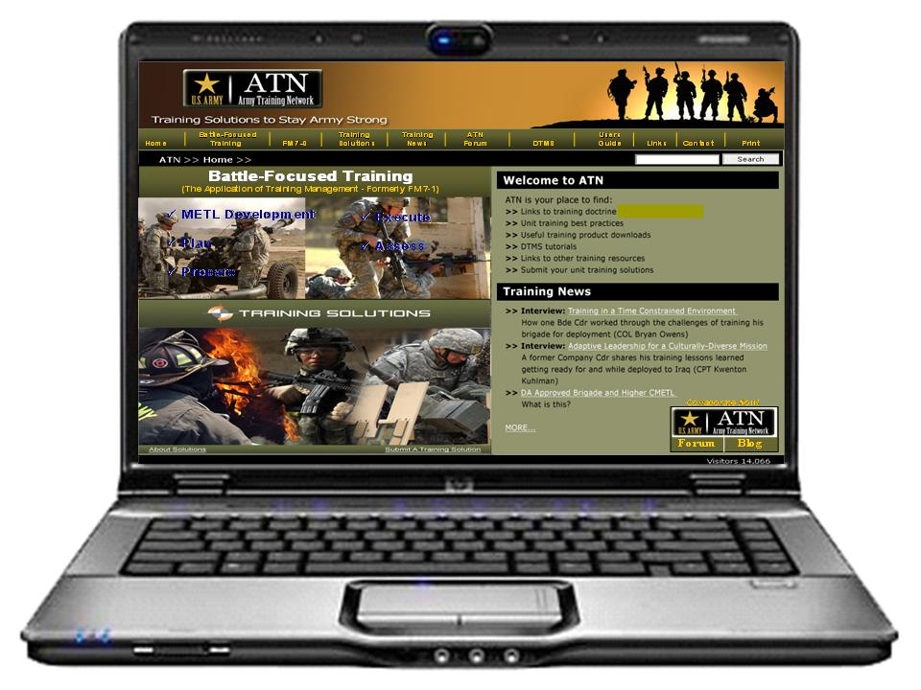
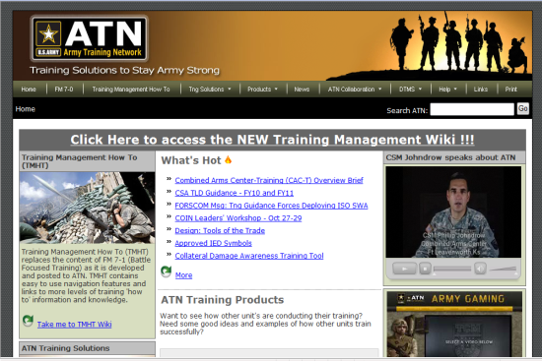
Army Training Network (ATN)
Complements FM 7-0, the “What” of
Army training management
ATN is about COLLABORATION - blogs, forums, and communication with the ATN team
ATN serves as the “How to” of Army
training management
Includes new content
    FM 7.0 Training Units and Leader Development for FSO
    Provides training solutions
    Training Management (TM) best practices
    Product used in the field
    Commanders’ Dialogue
    DTMS tutorials
    Embedded navigational links
    Available 24x7
FM 7-1
FMI 5
FMI 5
FMI 5
FMI 5
-
-
-
-
0.1
0.1
0.1
0.1
F
F
F
M
M
M
3
3
3
-
-
-
0
0
F
M
3
0
-
0
The
The
The
O
p
e
The
r
a
t
O
i
o
n
s
O
p
p
e
e
r
r
a
a
t
t
i
i
o
o
o
n
n
n
s
s
O
p
s
e
r
a
t
O
p
e
i
r
a
t
i
o
n
s
Battle Focused Training
I
I
I
I
I
I
S
S
S
T
T
T
I
I
I
I
I
I
:
:
D
:
D
S
S
T
T
R
R
B
B
U
U
T
T
O
O
O
N
N
N
R
R
R
E
E
E
R
R
R
C
C
C
T
T
T
O
O
O
N
N
A
N
A
A
p
p
p
p
p
p
r
r
r
o
o
o
v
v
v
e
e
e
d
d
d
f
f
f
o
o
o
r
r
r
p
p
p
u
u
u
b
b
b
l
l
l
i
i
i
c
c
c
r
r
r
e
e
e
l
l
l
e
e
e
a
a
a
s
s
s
e
e
,
,
d
d
i
i
s
s
t
r
t
r
i
i
b
b
u
u
t
t
i
i
o
o
n
n
i
i
s
s
u
u
n
n
l
l
i
i
m
m
i
i
t
t
e
e
d
H
d
H
E
E
A
A
D
D
Q
Q
U
U
A
A
R
R
T
T
E
E
R
R
S
D
S
D
E
E
P
P
A
R
T
M
E
N
T
O
F
T
H
E
A
R
M
Y
HEADQUARTERS
DEPARTMENT OF THE ARMY
Notes:
The Army launched the Army Training Network (ATN) in 2009 is a companion website to FM 7-0 which contains the “how to” or application of FM 7-0 training concepts; it also includes solutions to training challenges submitted to ATN for posting to share with others units. ATN is intended to be a “one-stop-shop” portal with information and hyperlinks to everything related to training throughout the Army. ATN contains collaborative features such as its own blog where users can discuss training issues with other users of the site.
It is extremely important to note that FM 7-1, Battle Focused Training., was superseded/replaced by the Training Management (TM) tab/link in ATN. The TM Tab/link contains all the “how to” doctrine, information , techniques and procedures (TTP) that was formerly in FM 7-1 however, like FM 7-0, the information has been changed and/or modified to reflex training for today’s complex OE, the challenges of ARFORGEN, and the requirement to conduct full spectrum operations (FSO).
The next slide provides an example of what the site currently looks like although the team developing it continues to work towards improving the functionality and information provided based on your feedback.

Slide 40
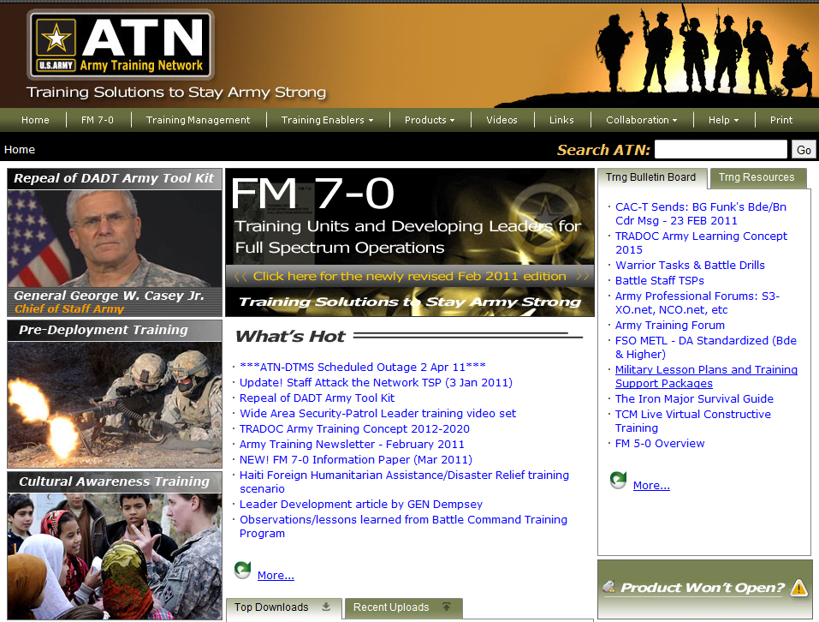
ATN Format
Notes:
Snap-shot of the screen for ATN.
Access to the online version of FM 7-0 is through the ATN homepage.
Have students open ATN on the CAC Net computers and pull this page up. Once they are all ready play the ATN Podcast which orients users to ATN or you explain the site walking them through the various tabs and menu selections.
Explain the FM 7-0 is best viewed digitally over ATN where they can leverage the many hyperlinks embedded in the manual. The next several slides walk the students through opening FM 7-0 on ATN and accessing some of the information the digital version of the manual makes available to them.

